Slide 1

THE ELITE MATCHMAKER
FIND YOUR PERFECT MATCH!
Abigail Albuquerque, Aria Yan, Isabel Herrero-Estrada, Megan Sin, Sandra Phan
Notes:
Abigail

Slide 2

OUR BUSINESS PROBLEM
The F1 has 10 different teams with different drivers each season. How should companies decide who is the most ideal to sponsor?
Elite matchmaker to the rescue!
Notes:
Abigail

Slide 3
WHY THE PROBLEM IS IMPORTANT?
There are a lot of factors to consider when choosing an ambassador for your company - public perception, popularity, nationality, interest in product type etc.
Our product makes the decision making process simple and efficient.
Notes:
Abigail

Slide 4
HOW WE MAKE A DIFFERENCE
Hundreds of hours would be spent by companies to research a perfect ambassador. Our product makes the process smart and efficient.
Companies can decide what factors they want to consider for their match.
Notes:
Abigail Especially with changing public perceptions.

Slide 5
OUR IDEA
WHAT KIND OF DRIVER DOES THE COMPANY WANT TO SPONSOR/ WHAT ARE THE COMPANIES INTERESTS?
BASED ON THEIR INTERESTS, MATCH THE COMPANY WITH THE PERFECT SPONSOR.
RANK THE DRIVERS
Notes:
Sandra

Slide 6
430 M
VIEWERSHIP PER RACE
$4 B
INDUSTRY
WHY SHOULD YOU INVEST?
GLOBAL REACH AND AUDIENCE
PRODUCT CAN BE TUNED TO FIT ANY SPORTING EVENT
WITH HUGE ROOM FOR GROWTH
Notes:
Sandra

Slide 7
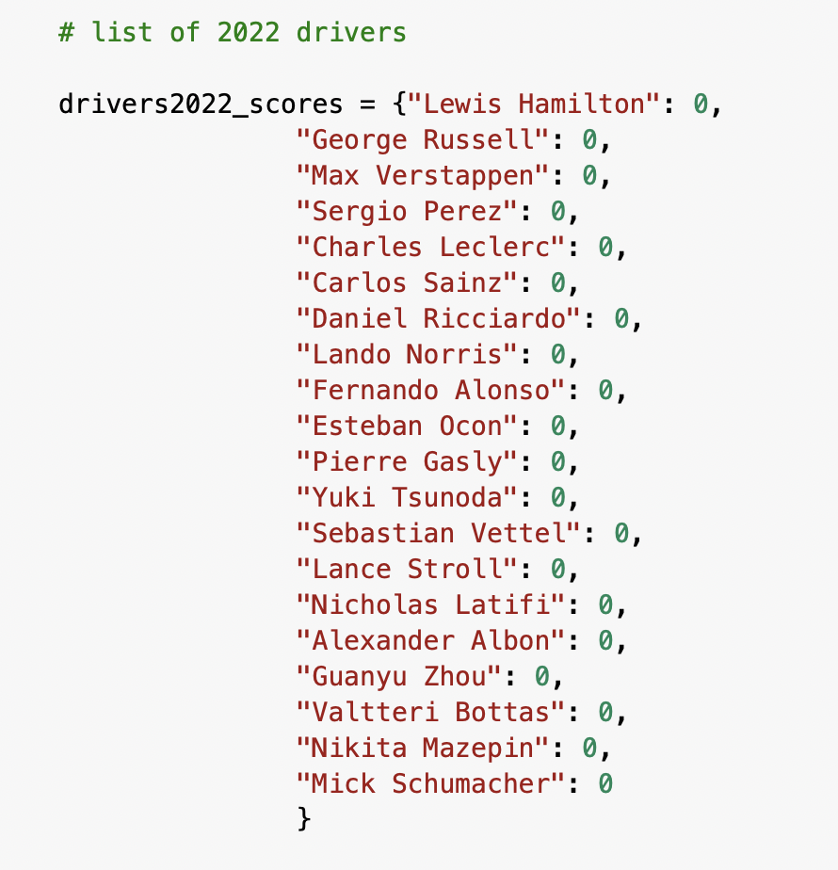
HOW OUR PRODUCT WORKS
COMBINES TWITTER DATA AND DATASET
LOOKS AT INTERESTS/TYPE OF COMPANY
SCORES DRIVERS BASED ON VARIOUS FACTORS
PROVIDES FINAL RANKING AND SCORE
INITIAL LIST OF DRIVERS SET WITH SCORE = 0
Notes:
Sandra

Slide 8
WHY WE USE NORMAL FOR OUR SCORING
To compare or add varying sizes of numbers
Tweet density is much smaller
Numbers like popularity or location are bigger
Notes:
isabel

Slide 9
DEMO
AND THE FUTURE OF OUR PRODUCT
Notes:
aria

Slide 10
Example 1 - A British Golfing Company
Ideally would sponsor a driver
who is popular
Engaged with golf
from the same country as company
Notes:
aria

Slide 11
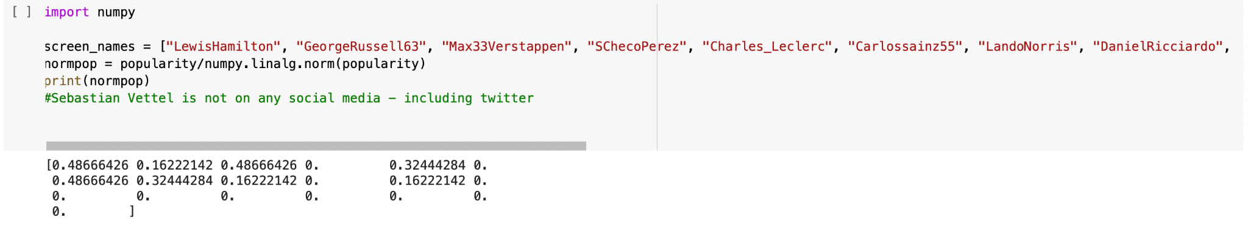
POPULARITY SCORE
BASED ON ANALYSIS, MOST POPULAR DRIVERS ARE LEWIS HAMILTON, MAX VERSTAPPEN AND LANDO NORRIS
Notes:
aria

Slide 12
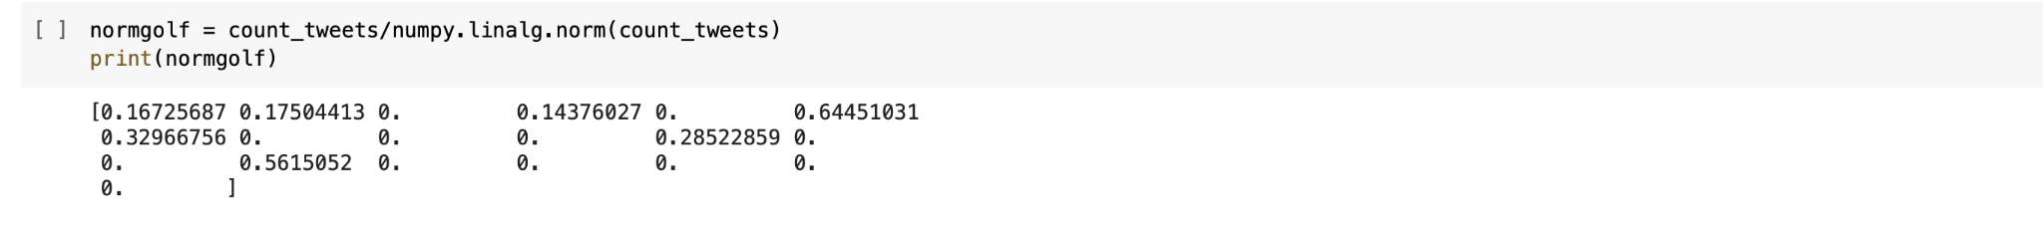
INTEREST IN GOLF SCORE
SEARCH KEYWORD - “GOLF”
BASED ON ANALYSIS, DRIVERS MOST INTERESTED IN GOLF ARE CARLOS SAINZ (0.644), NICHOLAS LATIFI (0.561) AND LANDO NORRIS (0.329)
Notes:
aria

Slide 13
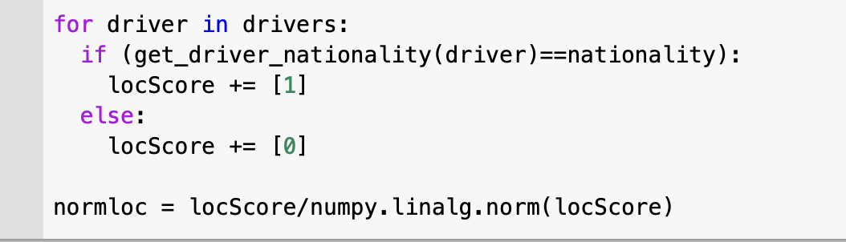
COUNTRY OF ORIGIN SCORE
NATIONALITY - BRITISH
DRIVERS - GEORGE RUSSELL, LANDO NORRIS, LEWIS HAMILTON
Notes:
aria

Slide 14
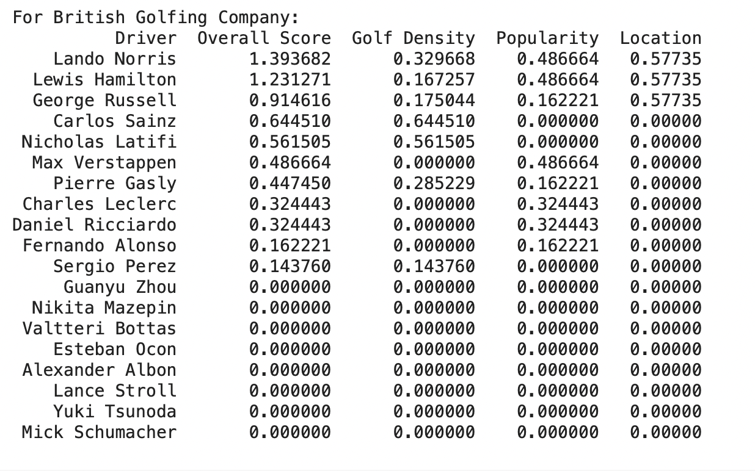
OUR FINAL RANKINGS FOR THE GOLFING COMPANY
Notes:
Norris has many tweets about golf, is a very popular driver, and is from the UK so he's ranked first. Hamilton tweets less about golf but is also very popular and is also from the UK so he's ranked second. Russell is less popular than Hamilton but tweets a bit more and is also British so he's ranked third. Sainz tweets the most about golf but is not very popular and isn't British so he's ranked fourth. This rudimentary formula weights golf tweet density, driver popularity, and driver location equally.

Slide 15
Example 2 - A Canadian Shoe Company
Ideally would sponsor a driver
who is popular
also has an interest in shoes
from the same country as company

Slide 16
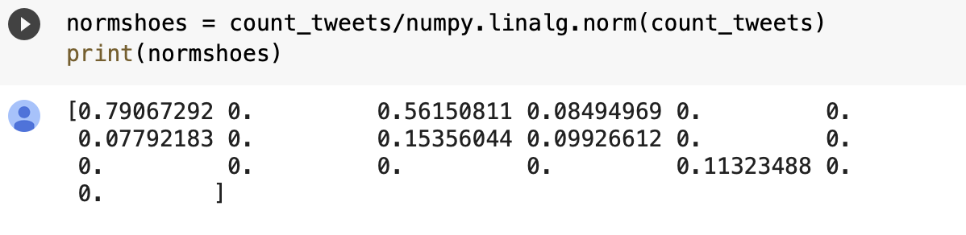
INTEREST IN SHOES SCORE
SEARCH KEYWORD - “SHOES”
BASED ON ANALYSIS, DRIVERS MOST INTERESTED IN SHOES ARE LEWIS HAMILTON(0.791), MAX VERSTAPPEN(0.561) AND FERNANDO ALONSO(0.153)
Notes:
Hamilton does a lot of ads for shoes already

Slide 17
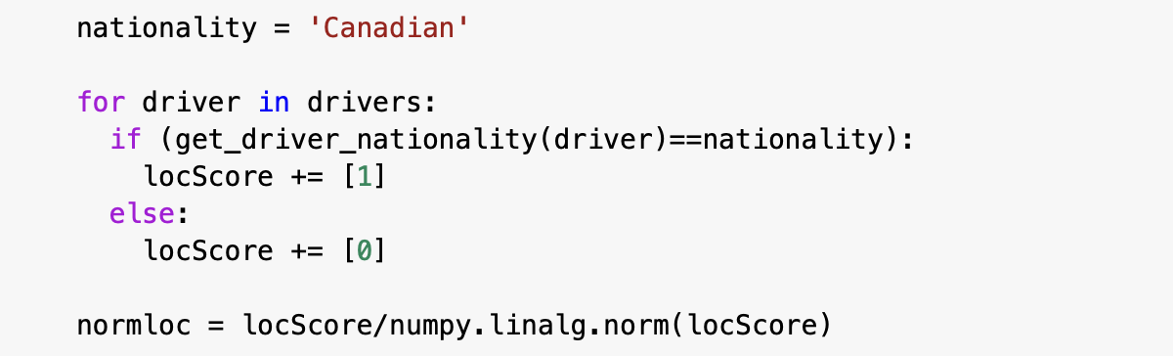
COUNTRY OF ORIGIN SCORE
NATIONALITY - CANADIAN
DRIVERS - LANCE STROLL, NICHOLAS LATIFI

Slide 18
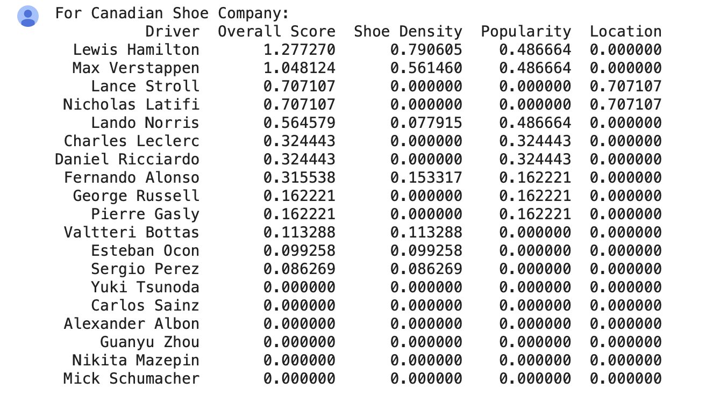
OUR FINAL RANKINGS FOR THE SHOE COMPANY

Slide 19
IN THE FUTURE…
INCLUDE TWITTER FOLLOWER DEMOGRAPHIC DATA
INCLUDE TWITTER FOLLOWER LOCATION
CONDUCT A FULL HISTORIC TWEET SEARCH INSTEAD OF USER TIMELINES TWEETS
INCLUDE BUDGETS AND OTHER ASPECTS
ANALYZE NOT JUST FOR DRIVERS, BUT TEAMS
Notes:
isabel

Slide 20
THANKS!
Do you have any questions?
Notes:
isabel

